Slide 1
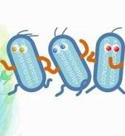
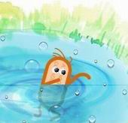
The gene pool

Slide 2
The Gene Pool
The total number of genes of every individual in a population.
This could be all the genes for all traits but we usually deal with just one gene at a time.

Slide 3
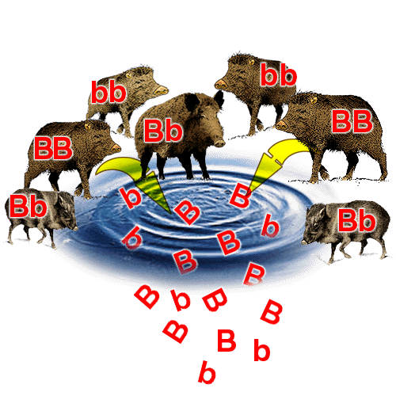

Slide 4
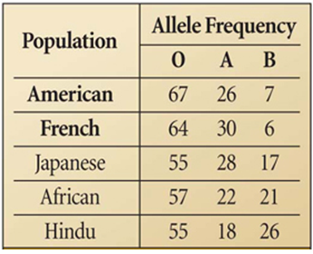
Gene frequencies
Each allele has a certain frequency.
Example: frequencies (percentages) for A, B and O blood type alleles
Note, frequencies are often given as decimals e.g. for American above: 0.67, 0.26, 0.07

Slide 5
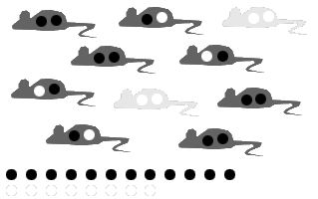
In the gene pool below, 60% (0.6) of the alleles are black (B) and 40% (0.4) are white (b). The percent of alleles in a pool is known as an allele frequency. The sum of all alleles in any pool must be 100% (1.0).

Slide 6
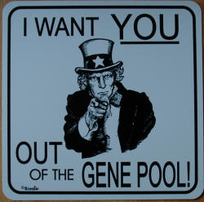

Slide 7
Changing Gene Frequencies
= EVOLUTION!

Slide 8
Changes to gene frequencies
The frequency of alleles in a population will remain the same over time if all of the following conditions apply:
No mutations occur
The population is large
Random mating occurs
No immigration or emigration occurs
No natural selection occurs
If one or more of these do not apply then gene frequencies will change over time (= evolution)

Slide 9
Sources of Variation
Mutation is the ultimate source of all variation. They are often recessive and harmful. Occasionally they are beneficial.
They have to be able to be passed on – gametic mutations rather than somatic.

Slide 10
Other variation
Crossing over in meiosis can produce new combinations of genes to make offspring different from parents and each other.
In sexual reproduction there is independent assortment of parental chromosomes in gamete formation then random joining of gametes in fertilisation.

Slide 11
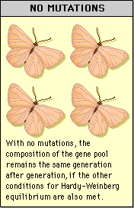
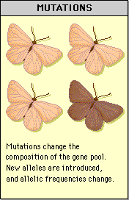
Mutation

Slide 12
Large Population
If a population is large, allele frequencies are unlikely to be affected by random events such as natural disasters

Slide 13
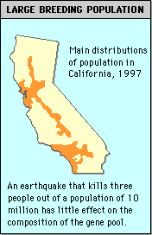
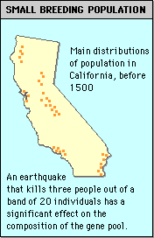
Large vs small population example

Slide 14
Genetic Drift
This effect is most important in small populations.
Allele frequency change simply due to chance
Populations subject to genetic drift have allele frequencies that differ from other populations and are often missing some alleles

Slide 15
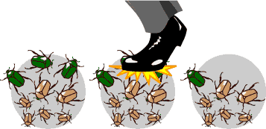
(Genetic Drift continued)
If an event such as a flood or fire randomly kills individuals with rare alleles, the frequency of those alleles is suddenly much lower.

Slide 16
Founder Effect
This is genetic drift occurring in groups formed from a few individuals leaving a large population
The founding group may have allele frequencies that differ from the parent population
These frequencies may be continued or increased over time

Slide 17
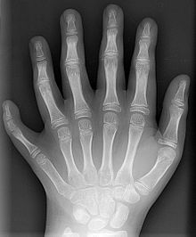
(Founder Effect continued)
Small island populations of animals and plants often show this.
American Indians virtually lack B blood
Some religious groups in The U.S.A. have unusual frequencies for blood type alleles and polydactyly is more common.

Slide 18
Population bottleneck
This is genetic drift occurring in groups in which a few individuals have survived an event that greatly reduced the size of the population.
Genetic diversity decreases and stays that way despite an increase in size.
Cheetahs in Africa show evidence of having passed through one about 10 000 years ago

Slide 19
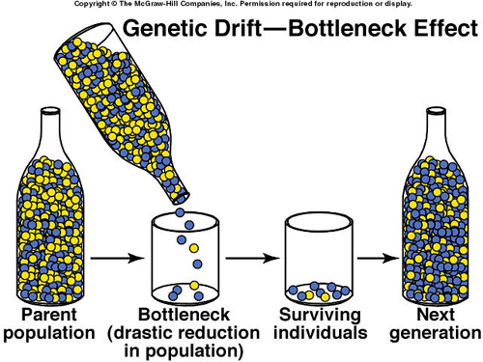

Slide 20
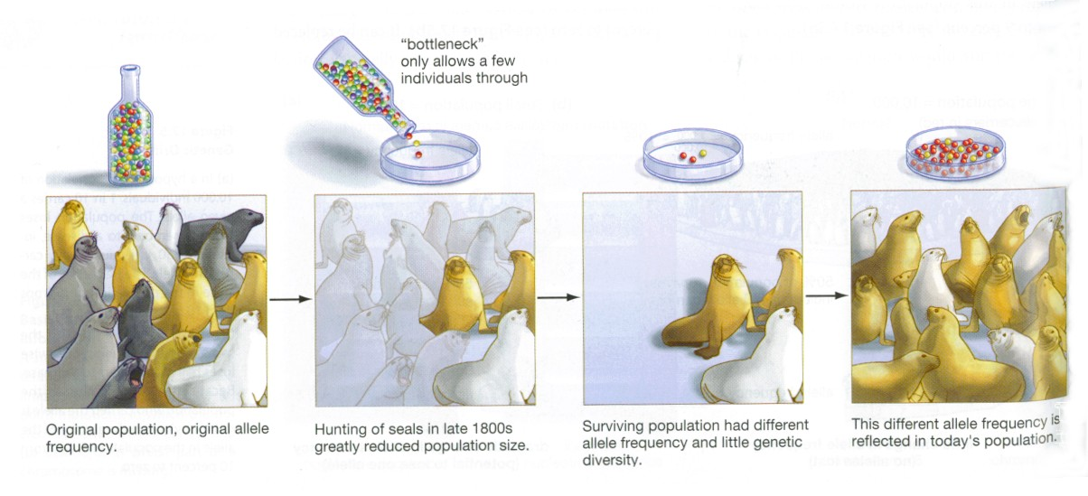
Bottleneck Effect

Slide 21
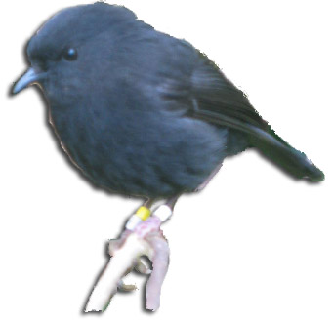

Genetic Bottlenecks
A disaster such as an eruption, fire or flood can reduce a population in a random way.
This is similar to the founder effect in that the gene pool becomes limited and open to genetic drift.
E.g. Chatham Island black robin
Cheetahs

Slide 22
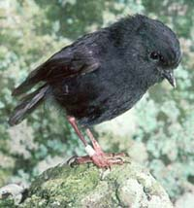
Old Blue
All of the 250 Chatham Islands Black robins alive today are descended from this female.

Slide 23
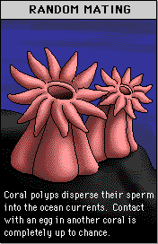
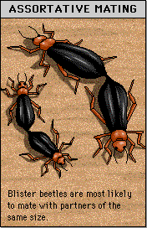
Random Mating

Slide 24
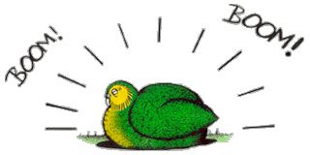
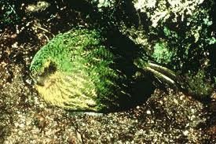
Non-random mating
Few species actually mate randomly.
Many mate with near neighbours in their own population.
Many select mates based on certain traits (e.g. long tail - peacocks).
Kakapo use Lek mating behaviour. Males “boom” on one spot and females are attracted to the “best” one.

Slide 25
Gene Migration (gene flow)
Individuals leaving (emigration) or entering (immigration) a population may change allele frequencies
They may introduce new alleles or deplete the population of certain alleles.
E.g. flow of sickle cell anaemia genes into North America with the slave trade.

Slide 26
Natural Selection
Darwin noted that all species produce many more offspring than are needed to replace the parents.
This leads to a struggle for survival.
The individual best adapted to their habitat survive and reproduce, those with less favourable variations reproduce fewer offspring or none at all.
Over time, the species changes and becomes better suited to its habitat.

Slide 27
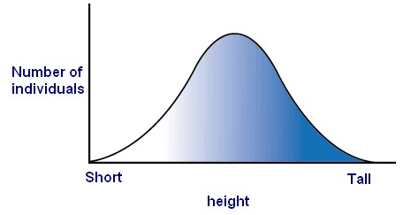
(Natural Selection continued)
For most traits a range of phenotypes exist that fall into a normal distribution with a bell shaped curve
E.g. Height
Selective forces such as predation, nutrients, amount of water etc. can act in the population in 3 ways:

Slide 28
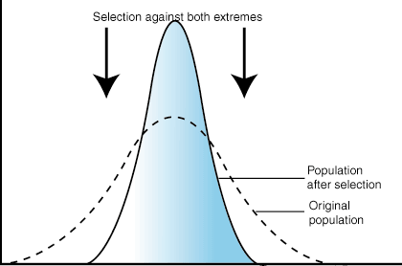
1. Selection against both extremes
The average is favoured.
This is Stabilising natural selection
E.g. human birth weights

Slide 29
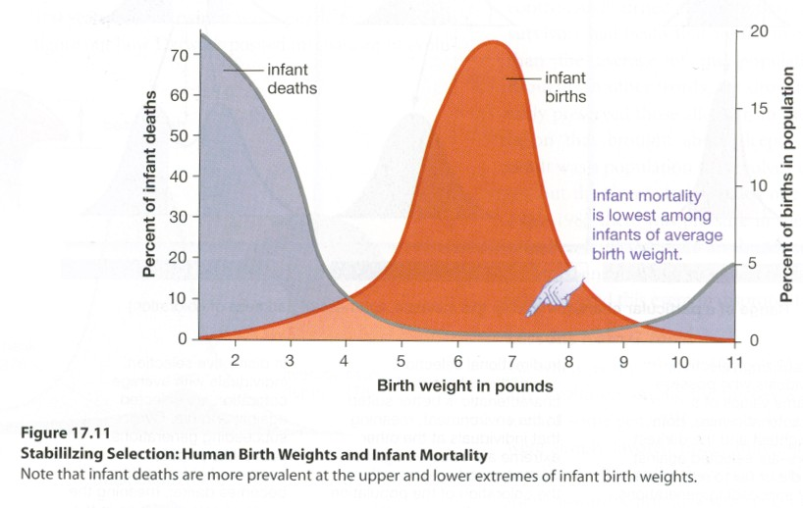

Slide 30
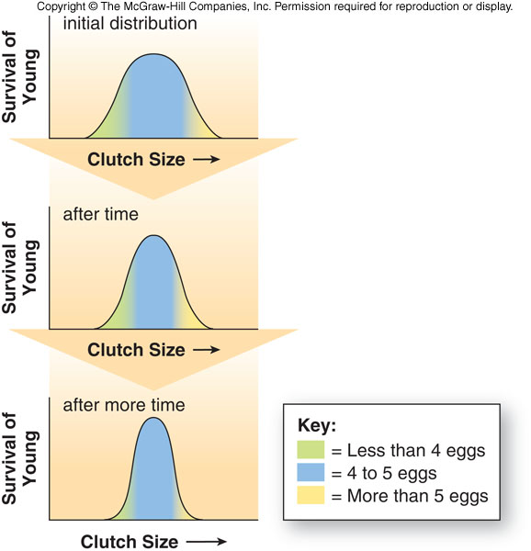
This example shows that small and large clutch size are selected against in some bird species so stabilising selection occurs

Slide 31
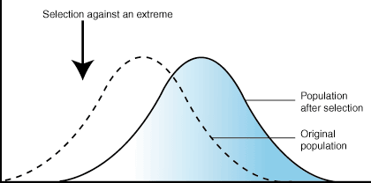
2. Selection against one extreme
One extreme is favoured.
This is Directional natural selection
E.g. Giraffe neck length

Slide 32
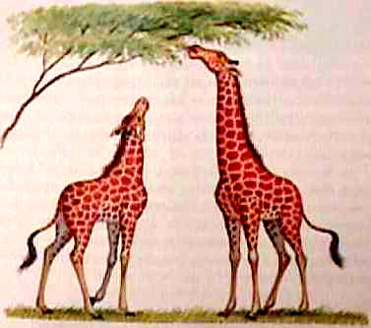
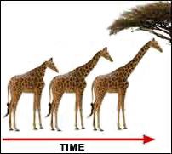
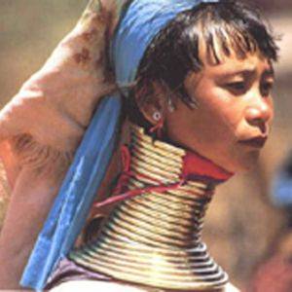

Slide 33
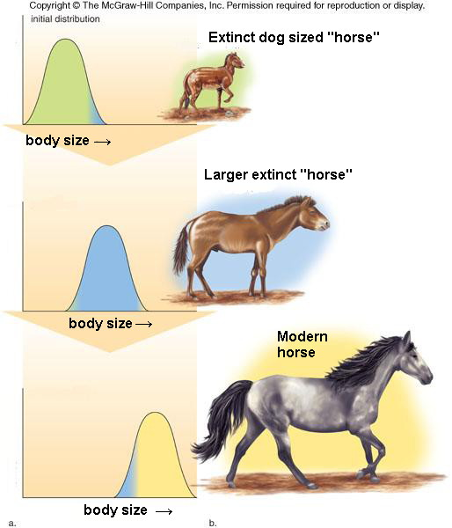

Slide 34
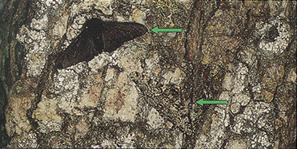
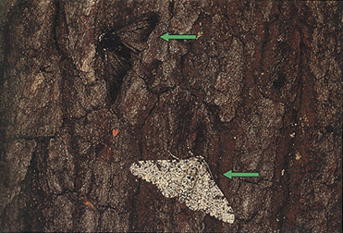
Peppered moths
Melanic (black) moths were selected against before the industrial revolution.
Light ones were selected against after the trees became covered with soot
Light moth

Slide 35
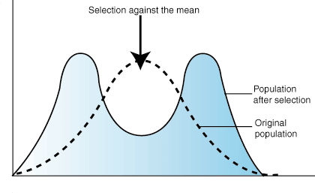
3. Selection against the mean
Both extremes are favoured. The mean is selected against.
This is Disruptive natural selection

Slide 36
Disruptive natural selection
E.g. When banded or unbanded snails are selected for but intermediate forms selected against. (see next slide)

Slide 37
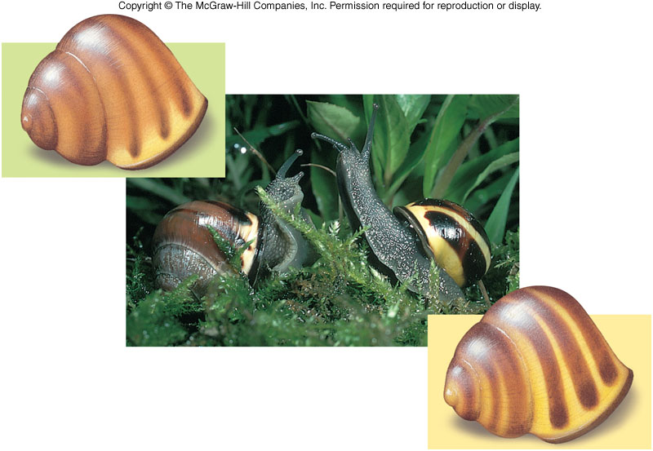
Cepaea snails (see Biozone)
Have a wide colour and banding range
Dark brown forms selected in woodland, but light yellow forms selected in grassland

Slide 38
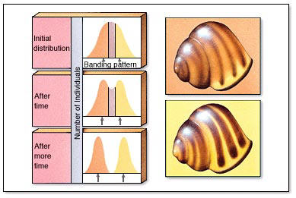

Slide 39
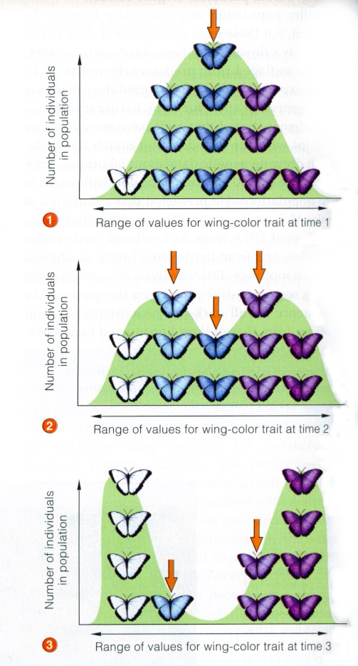
Another example in butterflies
Light AND dark selected for – middle shades selected against

Slide 40
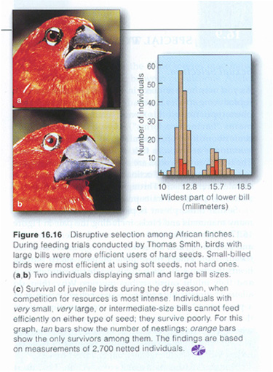

Slide 41

Natural Selection - Summary
Three types
  Stabilising
    Maintains allele frequencies
  Directional
    Favours one extreme
  Disruptive
    Favours both extremes but not the average

